Slide 1
Calvary Baptist Church 2024 Church Conference January 20, 2024
Calvary Baptist Church
3911 Garrison Boulevard
Baltimore, MD 21215
Dr. Stephen J. Russell Jr., Pastor

Slide 2
Agenda
Welcome
Prayer
Selection
Scripture
Reflection Video for 2023
Strategic Accomplishments for 2023
Budget Summary 2023
Proposed Budget 2024
Pastoral Direction
Annual Events for 2024
Closing Prayer
Calvary Baptist Church - Dr. Stephen J. Russell, Jr., Pastor
Notes:
Key take

Slide 3
Strategic Accomplishments

Slide 4
Strategy for Calvary in 2023
We must continue to support our vision to Redeem the World, Build Healthy Relationships, and Provide Relevant Ministry as we focus on strategies to:
Grow our membership
Increase our revenue
Members Finances
Calvary Baptist Church - Dr. Stephen J. Russell, Jr., Pastor
Notes:
Key take

Slide 5
Goals for 2023
In 2023, we identified 3 strategic goals we wanted to achieve
Engage our people
To grow our membership
To increase our revenue
Calvary Baptist Church - Dr. Stephen J. Russell, Jr., Pastor
Notes:
Key take

Slide 6
Achievement – Engage our Members
In 2023, we held roughly 16 activities to engage our members and the community.
Launch of Young Adult Ministry (Experience) | Back-To-School Community Event
Women’s Book Discussion | Crab Feast
Women’s Tea Social | Outdoor Movie Night Meet Up
Youth Outreach Virtual Fundraiser | Fall Extravaganza MockTail Party
Ministry Fair | New York Shopping Trip
Football Fellowship | Girl’s Ministry Monthly Meeting
Trunk or Treat Fall Festival | Brotherhood of Calvary (Mens) Breakfast
Pull Up to the Park | The Anatomy of Faith bible study
Men’s Book Study “No More Excuses” Tony Evans | New Years Eve Celebration Party
Calvary Baptist Church - Dr. Stephen J. Russell, Jr., Pastor
Notes:
Key take

Slide 7
Achievement – Grow our Membership
In 2023, we welcomed 32 new members to God’s family
9 - Adults
13 - Young Adults
10 – Children
To God be the Glory!
Calvary Baptist Church - Dr. Stephen J. Russell, Jr., Pastor
Notes:
Key take

Slide 8
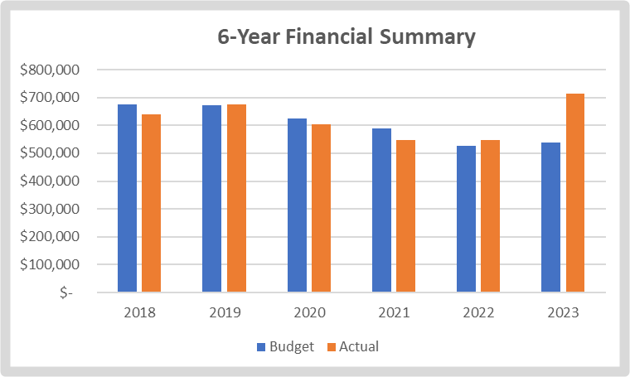
Achievement – Increase in Revenue
In 2023 our financials are trending in the right direction
Due to your faith and commitment in giving, our 2023 revenues increased by 31% over 2022.
To God be the Glory!
Calvary Baptist Church - Dr. Stephen J. Russell, Jr., Pastor
Notes:
Key take

Slide 9
Operational Improvements
In addition to our strategic achievements, we also improved our internal processes
Ten ministries created ministry-specific strategic plans, and goals for 2023 and 2024.
Initiated the implementation of new church management software (Planning Center) to replace Fellowship One.
Calvary Baptist Church - Dr. Stephen J. Russell, Jr., Pastor
Notes:
Key take

Slide 10
Capital Improvements
Capital Improvements:
Replaced (17) windows in the community building.
Painted the men’s bathroom and hall in community area.
Purchased (3) air conditioners for the classrooms.
Installed (5) Security grates for air conditioners in classrooms, Admin office, and Pastor’s office.
Upgraded and installed Fellowship Hall media (TV and surround-sound) and repaired the electrical systems.
Installed a new fence between the church and white house and new fence around the back of the church.
Repairs and Inspection/Recertifications:
Made necessary repairs to the chair lift and completed the inspection for the year.
Completed sanitizing the kitchen and passed the inspection for the year.
Completed the fire and safety inspection for the year.
Calvary Baptist Church - Dr. Stephen J. Russell, Jr., Pastor
Notes:
Key take

Slide 11
Goals for 2024
In 2024, we will continue to build and expand on the plans we started in 2023 to:
Engage our people
To grow our membership
To increase our revenue
Calvary Baptist Church - Dr. Stephen J. Russell, Jr., Pastor
Notes:
Key take

Slide 12
Plans for 2024
In 2024, we will continue to:
Help ministries achieve their 2024 strategic goals and objectives
Continue to strengthen the new Young Adult Experience Ministry.
Build up our ministries for Teen Girls and Boys
Expand our financial growth strategies
Implement a new Calvary Baltimore website
Continue member engagement activities
Provide more spiritual growth classes
Complete replacement of Fellowship One with Planning Center
Calvary Baptist Church - Dr. Stephen J. Russell, Jr., Pastor
Notes:
Key take

Slide 13
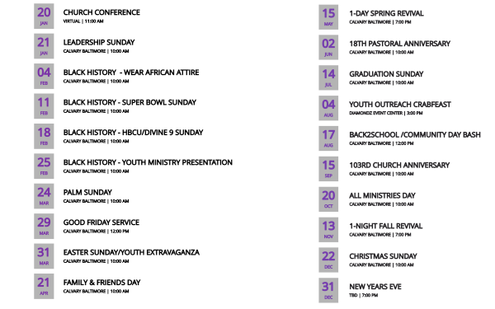
2024 Annual Events
Calvary Baptist Church - Dr. Stephen J. Russell, Jr., Pastor
Notes:
Key take

Slide 14
Thanks for All You Do!

